Slide 1
Video Games Sales
Analysis
Group 4
-Cassandra Brown
-Brenden Mertz
-Jweta Patel
-Rafael Quintero
-Diana Villarreal
Notes:
Diana

Slide 2
Overview
Selected topic
Reason the topic was selected
Description of the source of data
Questions the team hopes to answer with the data
Description of the data exploration phase of the project
Description of the analysis phase of the project
Technologies, languages, tools, and algorithms used throughout the project
Result of analysis
Recommendation for future analysis
Anything the team would have done differently
Notes:
Diana

Slide 3
Selected Topic
We will be laying the foundation for our analysis by processing and exploring a large amount of data on video game sales. The dataset contains information regarding the sales of video games across various regions like North America, Europe, Japan and also globally, while also giving information regarding the Names, Publishers and Platforms.
Notes:
Diana

Slide 4
2. Reasons the Topic was Selected
The world is getting more connected every day, and more gaming trends and preferences are emerging around the globe.
We want to know which console is preferred the most based on different regions.
We will compile results from all over the world and determine if any regional trends might shape the gaming industry as a whole.
It's great stress relief and some games are just so much fun to play , Enjoyment for all age people.
Notes:
Diana

Slide 5
3. Description of the Source Data
The datasets we used are from Kaggle which is the home for many datasets and competitions.
Our data is comprised from three different data sets found on Kaggle. These datasets have video game titles, genres, console types, of games sold, dates, and region it sold in.
Notes:
Diana

Slide 6
4. Questions We Hope to Answer with the Data
What genre of game sells best?
What seasons do games sell the best?
What region games sell the best?
Overall comparisons between genre, console types, dates sold, and regions sold in?
Notes:
Diana

Slide 7

Database
SQLITE database was created
Datasets were uploaded to database
Datasets were joined into one
Database is connected to model via SQLAlchemy
Notes:
Rafa

Slide 8
5. Data Exploration Phase
Description of preliminary data preprocessing
The data was cleaned and filtered to display the three primary consoles for this analysis. Data from two other sources were combined in order to create the database and add additional data points.
Description of preliminary feature engineering and preliminary feature selection, including their decision-making process
Once in python, the global and other countries categories were combined in order to create one. In order to conduct the analysis of genre and sales by country, dummy variables were generated to change the object data type to numeric. A heat map and scatter plot were developed in order to determine the relationship if any existed between the desired test variables.
Notes:
Rafa

Slide 9
5. Data Exploration Phase Cont’d
Description of how data was split into training and testing sets
Ultimately, the primary goal was to create a sales projection based on genre and region. In order to do this the data was split into training variables by 0.4. This decision was based on research from different sales analysis conducted and our own data set. The reminder of the data points were used for the testing model.
Explanation of model choice, including limitations and benefits
For this analysis linear regression was the model choice selected. It is a supervised machine learning model that allows for target prediction of the independent variable. Since this model can determine if a specific genre of game will sale better in a different region this model a good choice for this analysis. One of the main limitations of this model is the reliance on linear relationships. It is based on the assumption that the relationships at their core are linearly connected, however this may not truly be the case.
Notes:
Rafa

Slide 10
6. Analysis Phase
The analysis phase will be demonstrated via the Tableau Visualization Dashboard which will chart game sales over time and will be filterable by game genre, console type, and region. We will be able to predict sales trends on each as well as review historical data.
For Example:
We can see that sales have been continually increasing over time.
North America has been the leader in video game sales for the most part, however, Japan looks like it was able to surpass North America briefly between 1992 and 1996.
Notes:
Cassandra

Slide 11
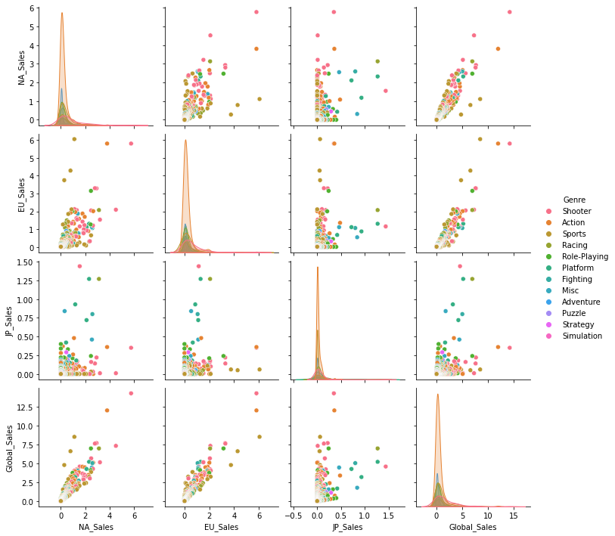
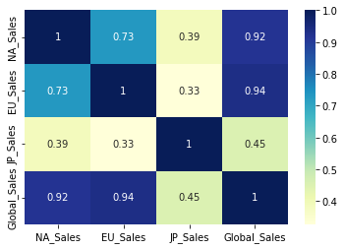
Analysis cont’d
The above graphs demonstrate that there is a relationship between genre and sales, that also exhibits linearity.
Notes:
cassandra

Slide 12
7. Technologies, Languages, Tools, and Algorithms Used
Jupyter notebooks was used to perform a simple linear regression in python to model predicted sales by genre.
Dummie variables were assigned to the genre categories to give them a numerical value.
The model was trained and split using :
train_size = 0.7, test_size = 0.3, random_state = 100
This was repeated for the four regions with a map and coefficient generated for each country.
The each model was trained using the same method to keep consistent.
Notes:
Cassandra
Discuss the training and how it was consistent. Why regression was chosen and the dummie vairables

Slide 13
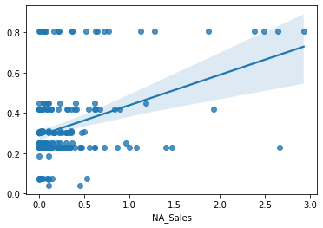
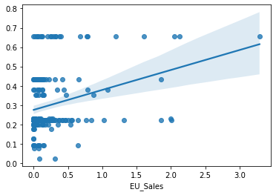
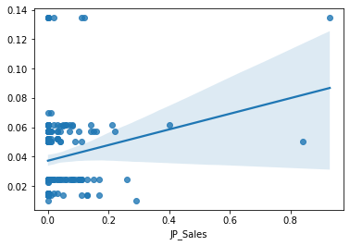
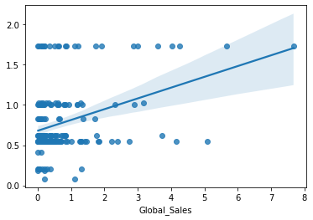
8. Results of Analysis
North America
Europe
Japan
Other Countries
Notes:
Cassandra
Linear regression line, explain it
x= sales by country
y = genre

Slide 14
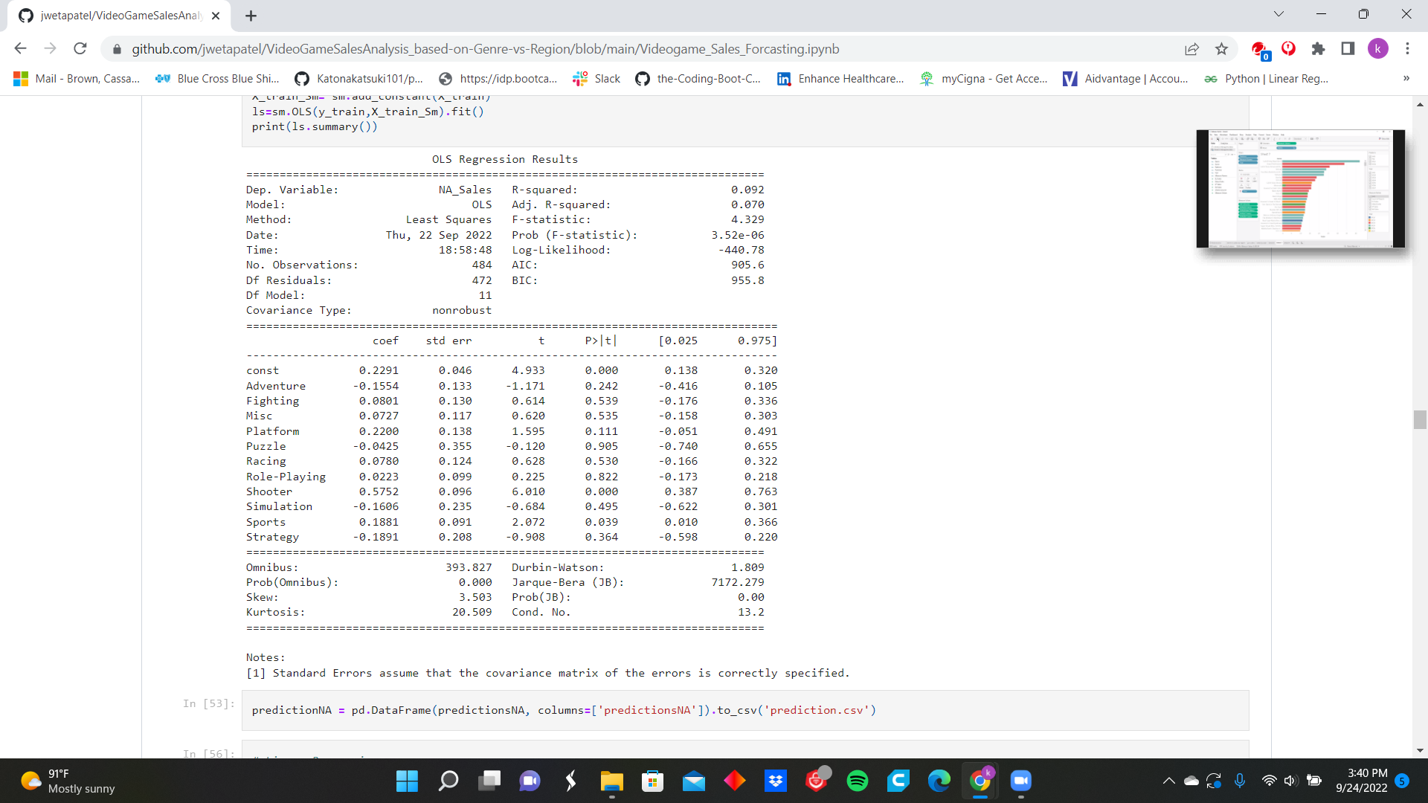
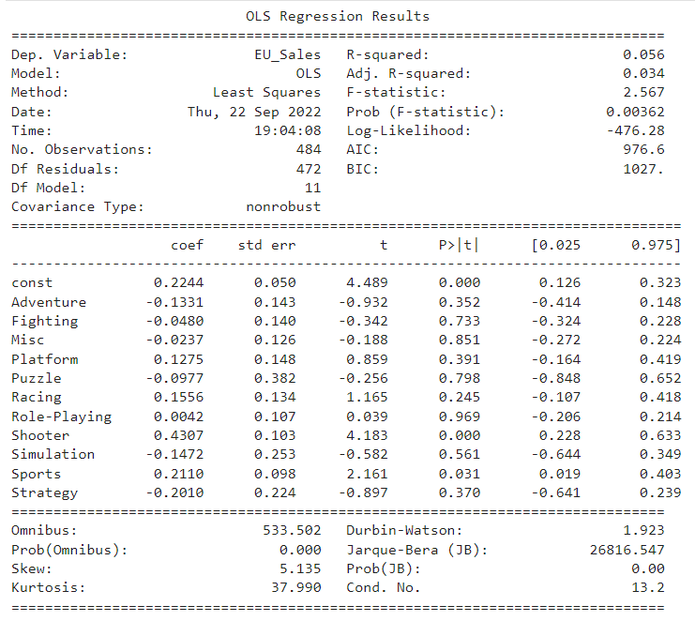
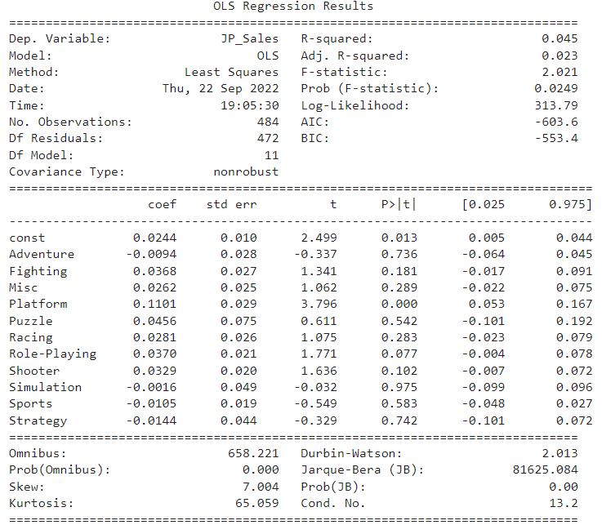
Results of Analysis cont’d
Notes:
Cassandra
-discuss the accuracy, coefficients, and p value. Statistical significance, and why the values were not changed.

Slide 15
Dashboard Link
https://public.tableau.com/app/profile/diana.villarreal1441/viz/VideoGamesSalesAnalysis-Group4/Dashboard14?publish=yes
https://public.tableau.com/app/profile/diana.villarreal1441/viz/VideoGamesSalesAnalysis-GroupGenreYear/Dashboard12?publish=yes
https://public.tableau.com/app/profile/diana.villarreal1441/viz/VideoGamesSalesAnalysis-GroupSales/Dashboard1?publish=yes
https://public.tableau.com/app/profile/diana.villarreal1441/viz/VideoGamesSalesAnalysis-Group4TopGames/Dashboard13?publish=yes
Notes:
Jweta

Slide 16
9. Recommendations for Future Analysis
Adding a population metric for each region to present the data in percentages for better comparison.
Adding more console types from eighth and ninth generations, such as the Nintendo Switch, PS5, Xbox One Series X, etc.
Asd
asd
Notes:
Brenden

Slide 17
10. Things We Would Have Done Differently
Not Needed for Deliverable 2.
Notes:
Brenden

Slide 18

Thank you!
Notes:
Brenden

